Slide 1

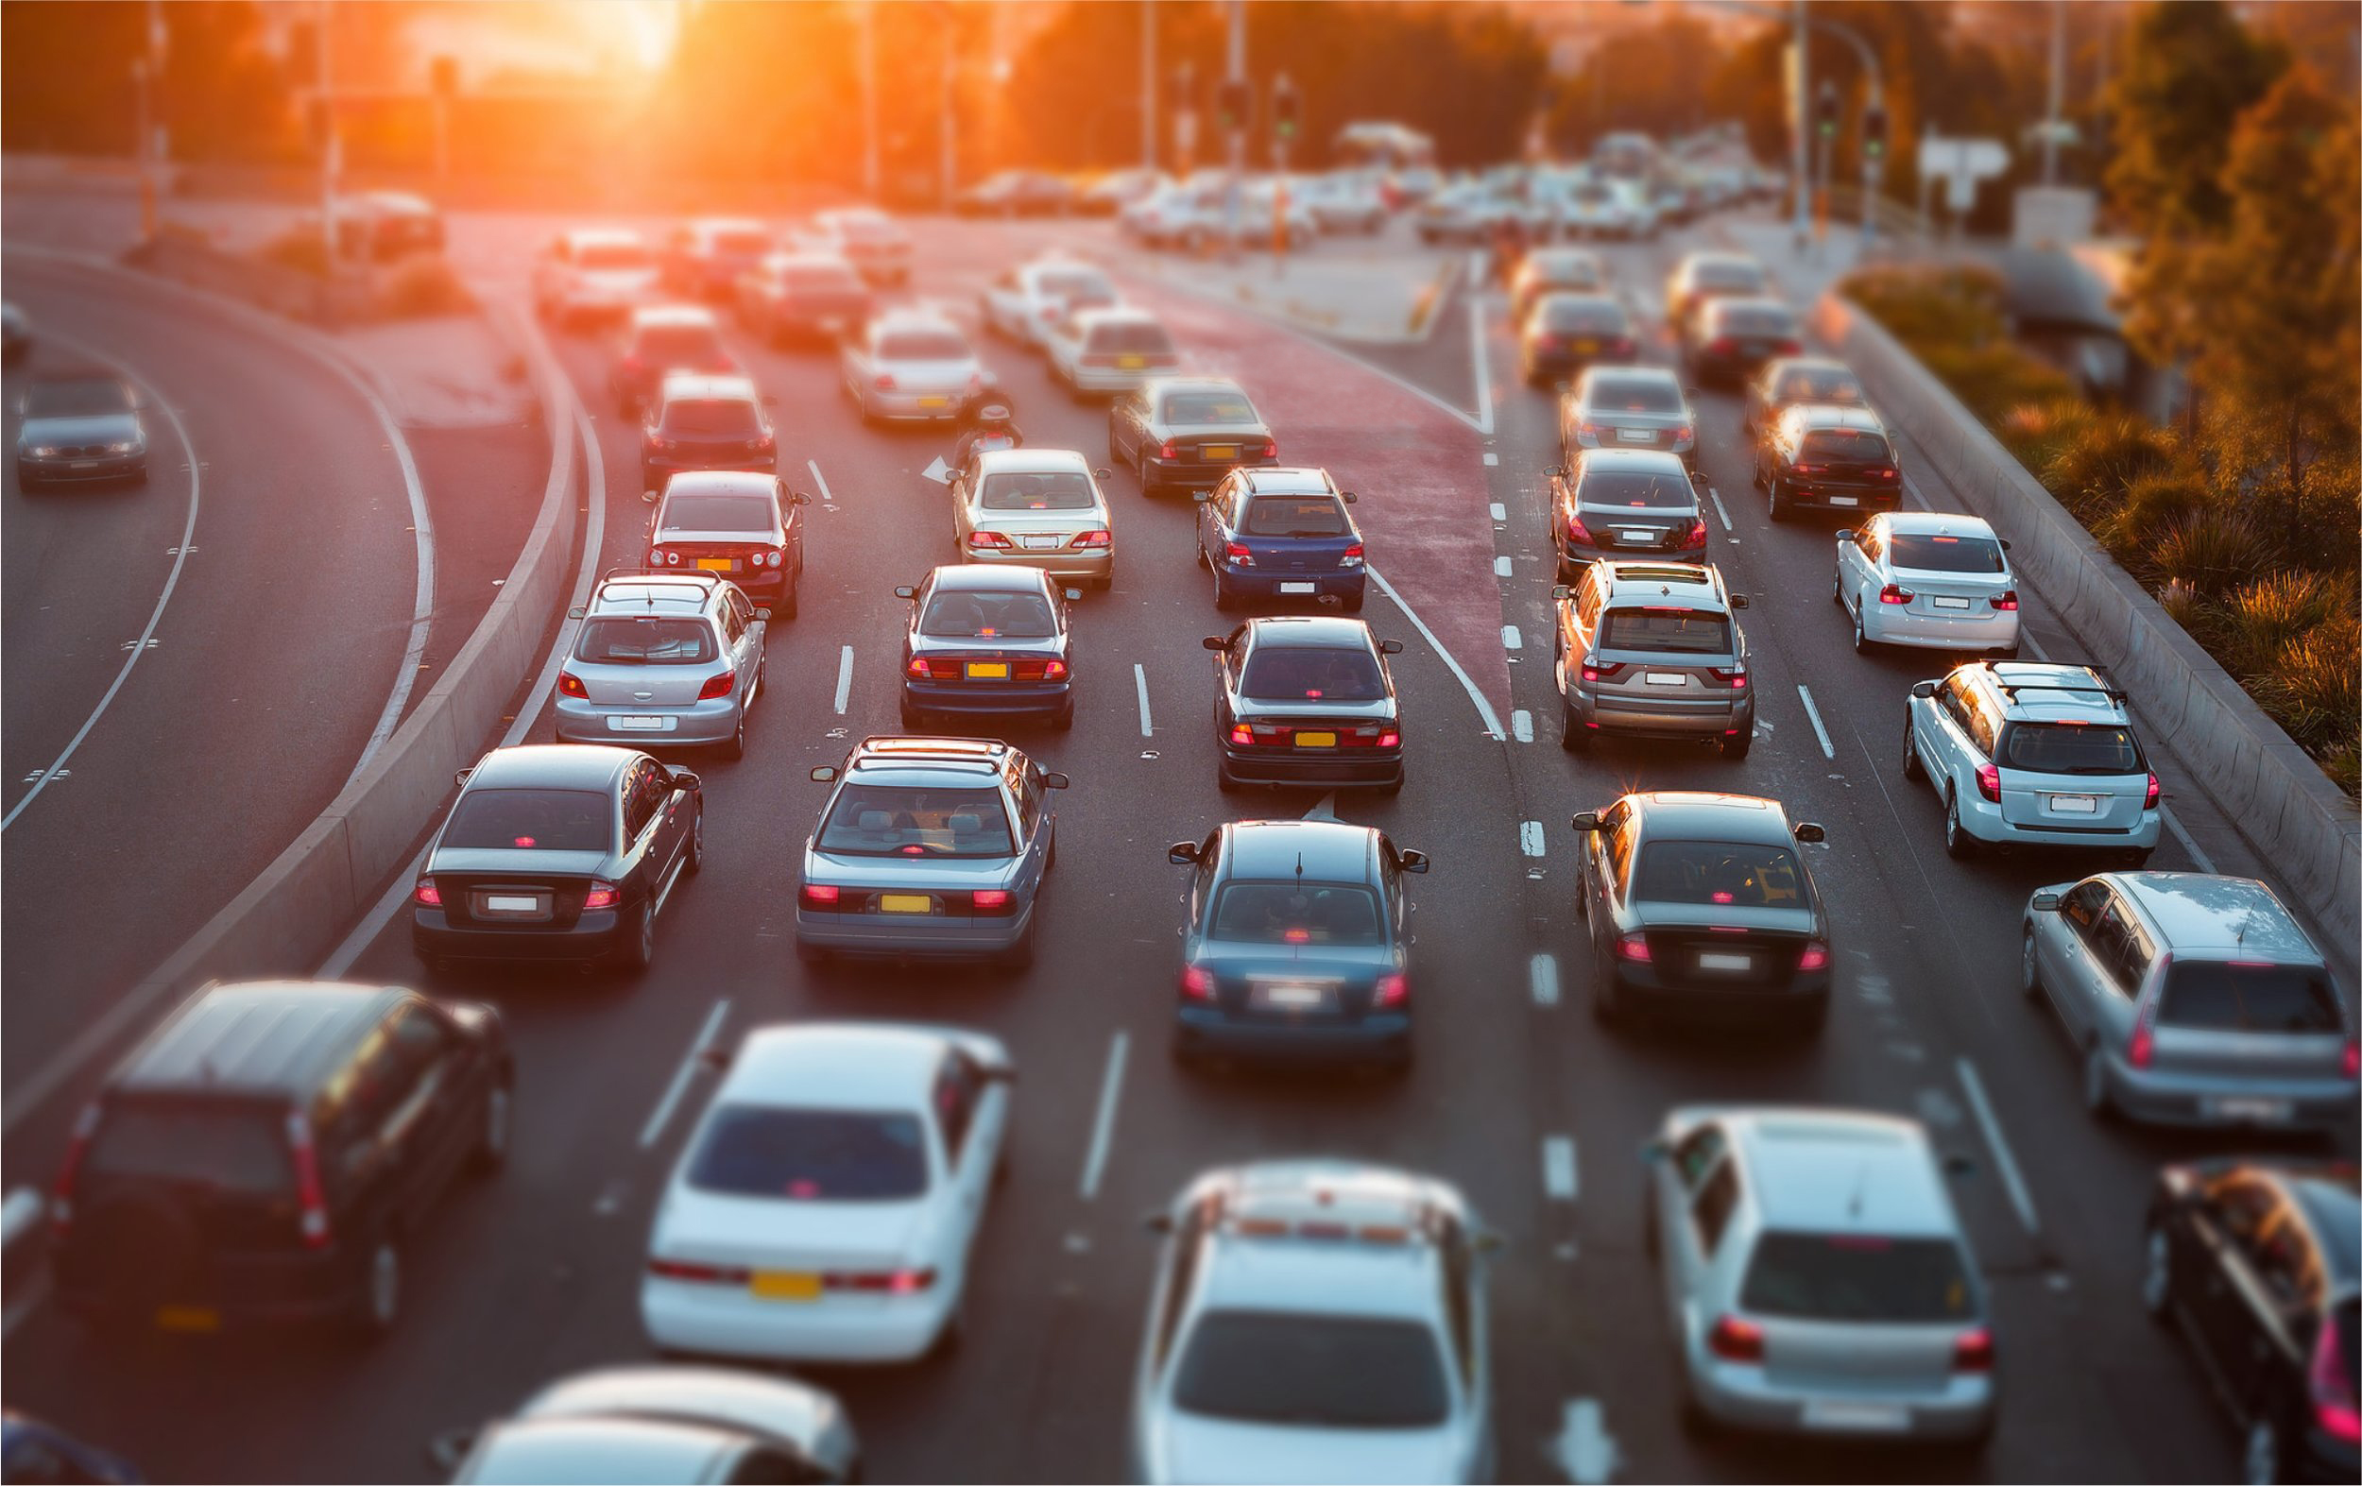
Exploratory Data Analysis Techniques for Traffic Flow Prediction: Univariate, Bivariate, and Multivariate Approaches
Realized by :
AQACHTOUL ABDERRHAMNAE
Responsible :
Pr. Sabiri Mohamed

Slide 2
01
Introduction
table of content
02
Methodology
03
Results
04
Conclusion

Slide 3

Introduction
Let's embark on this journey into the realm of traffic prediction. With a history spanning over half a century, this field has explored short-term and long-term forecasts, envisioning traffic conditions from mere minutes to entire weeks ahead. From gauging traffic congestion and flow to estimating travel times, the predictive arsenal encompasses various tools, including Recurrent Neural Networks, LSTMs, and GRU. Notably, even platforms like Google employ these techniques to anticipate travel durations, reflecting the captivating nature of this extensively researched domain.
Notes:
So yeah, let's start. Traffic Traffic prediction is a quite well-known topic. Research on traffic prediction started more than 50 years ago. We can try to predict traffic in the short term, so try to predict what may happen in 10 or 15 minutes ahead, or we can try to do long-term traffic prediction, so predict what may be the state of traffic next day or next week at the same time of day, for example.
And we can try to predict traffic congestion, so traffic flow number of cars driving through a given road segment. We can also try to predict travel times. So travel times is something which is predicted, for example, by Google service when we want to find optimal routes, then each time Google not only analyzes current traffic data and historical traffic data, but also try to forecast short-term travel times. So usually good tools to make such traffic predictions are Recurrent Neural Networks, LSTMs or GRU. There are a lot of research papers on this topic, and it is indeed a very interesting topic.

Slide 4

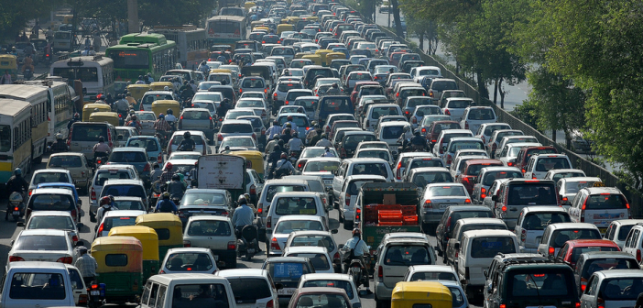
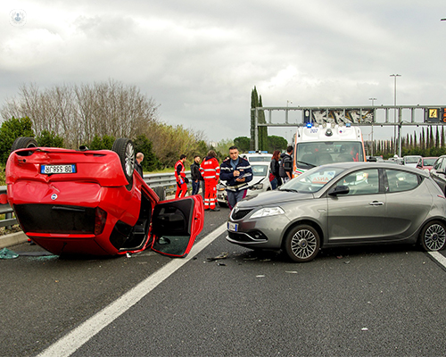
Introduction
Problematic
Drivers in 7 largest Polish cities lose yearly ~4 bln PLN due to traffic jams
1.3 mln people die each year in car accidents 20 mln are wounded
Notes:
So right now, thousands of drivers in Warsaw stay in traffic jams, losing, wasting time, money.0:00:43And it is estimated that drivers in seven largest Polish cities lose yearly almost 4 billion Polish zloty because of traffic jams. Also, more than 1 million people each year die in car accidents and about 20 million are wounded.

Slide 5

Introduction
Solutions :
EDA
Univariate Analysis
Bivariate Analysis
Multivariate Analysis
Artificial intelligence
Machine learning
Deep learning

Slide 6
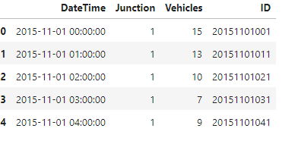
Methodology
1. Acquisition of the dataset
This dataset is a collection of numbers of vehicles at four junctions at an hourly frequency. The CSV file provides four features:
DateTime
Junctions
Vehicles
ID
The table below shows an extract from the database :

Slide 7
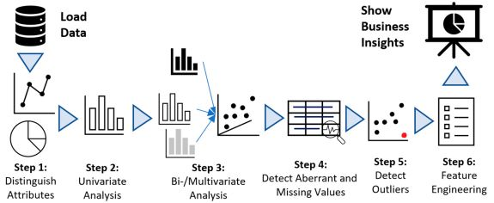
Methodology
2. Exploratory Data Analysis (EDA):
Exploratory data analysis (EDA) is used by data scientists to analyze and investigate data sets and summarize their main characteristics, often employing data visualization methods.

Slide 8
Methodology
2. Exploratory Data Analysis (EDA):
01
Univariate
there is only one dependable variable.
EDA
02
Bivariate
the relationship between the two variables..
03
Multivariate
when more than two variables have to be analyzed simultaneously.

Slide 9
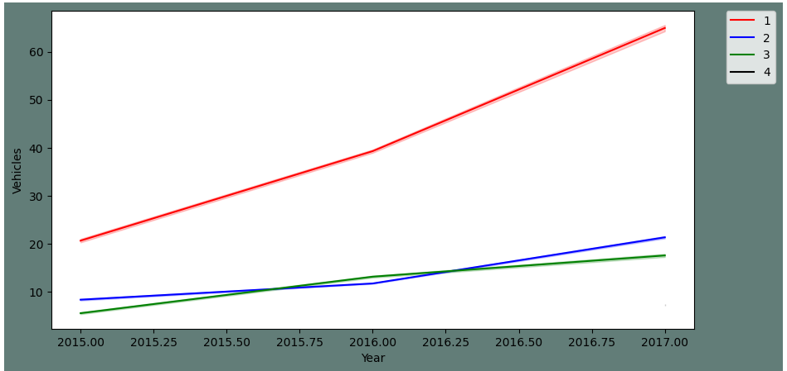
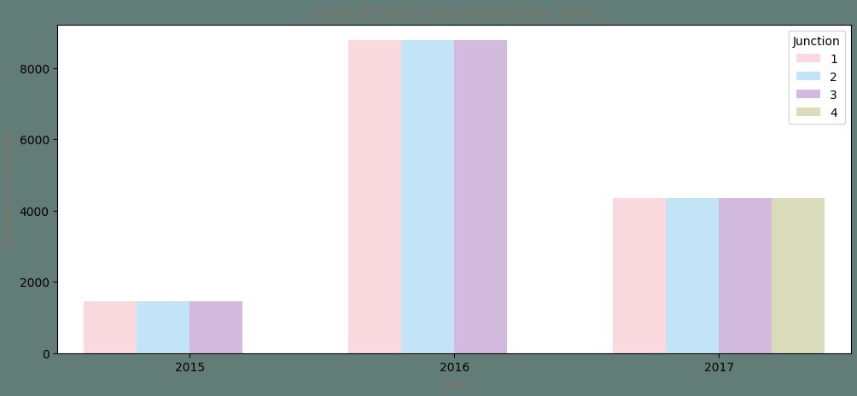
Methodology
2. Exploratory Data Analysis (EDA):
After applying eda techniques on our dataset here are some results:

Slide 10
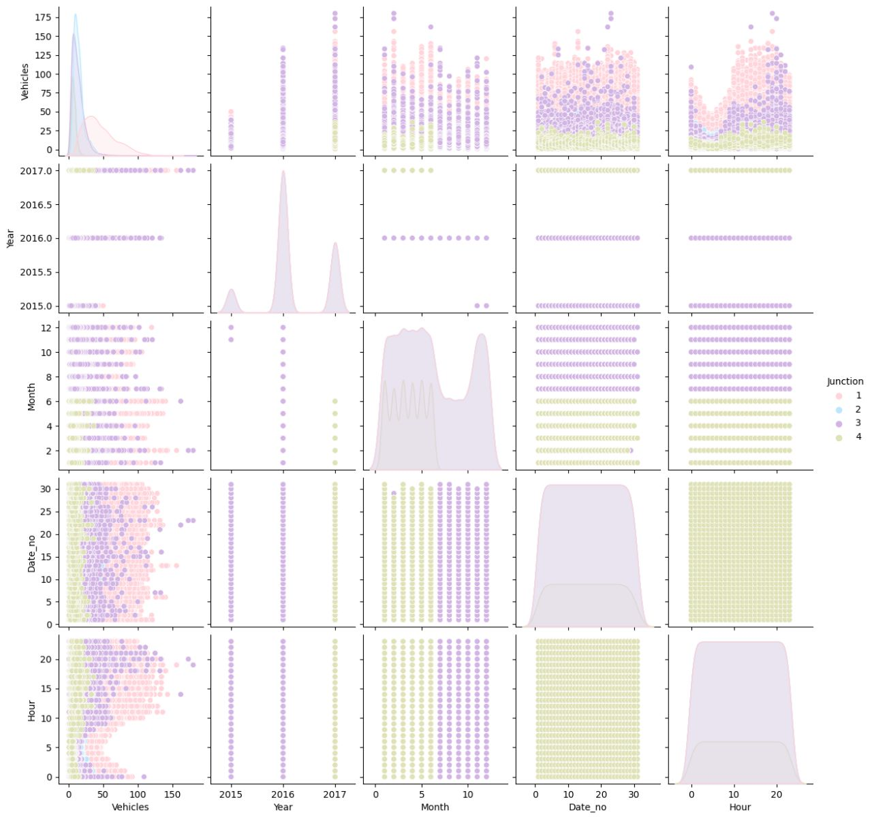
Methodology
2. Exploratory Data Analysis (EDA):
After applying eda techniques on our dataset here are some results:

Slide 11
Methodology
2. Exploratory Data Analysis (EDA):
According to the results extracted by the EDA techniques can conclude :
The span of data from all four junctions is not the same. Data provided for the fourth junction is limited to only 2017.
The yearly trend for Junctions one, two and three have diffrent slopes.
Junction number one has a more strong weekly seasonality in comparison to the other junctions.

Slide 12
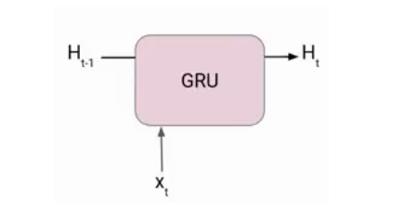
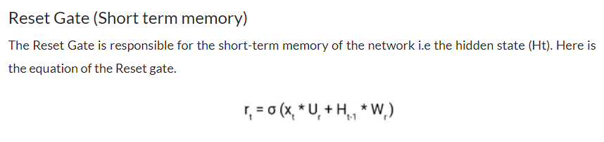
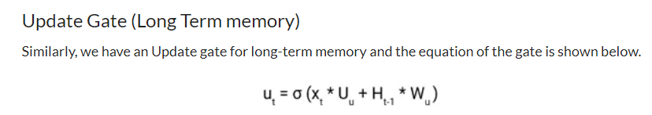
Methodology
3. Gated Recurrent Unit (GRU)
We have settled to use Gated Recurrent Unit (GRU) for the model building and fitting.

Slide 13
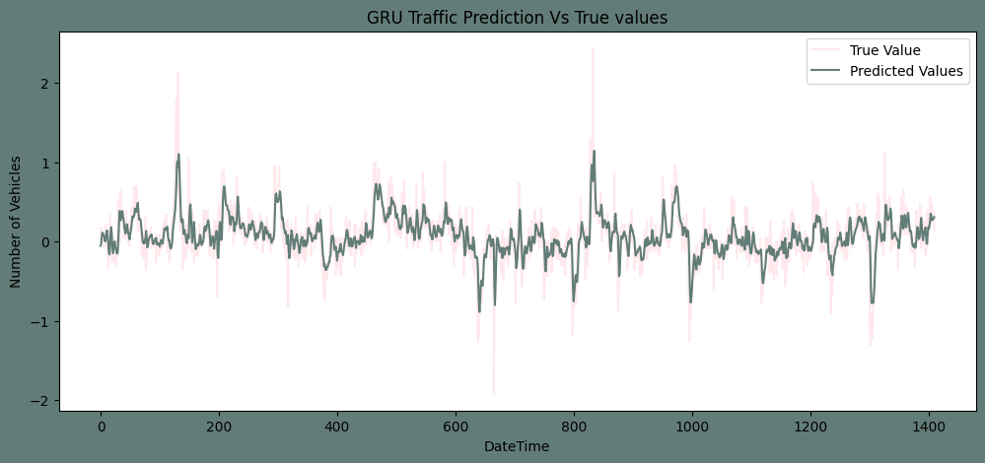
Results
after fitting the transformed training sets of four junctions to the model created and comparing them to the transformed test sets. here are the results obtained for the 4 junctions:

Slide 14
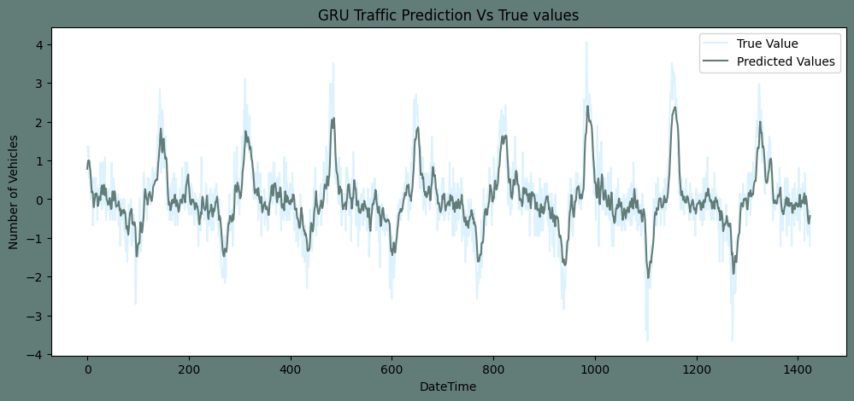
Results
Notes:
We applied the k-means algorithm to cluster participants based on their current status and level of study. The features were current status and level of study, and the target was the cluster label generated by the k-means algorithm. The optimal result of k-means was 6 clusters, and these clusters had different frequencies(see figure 13).

Slide 15
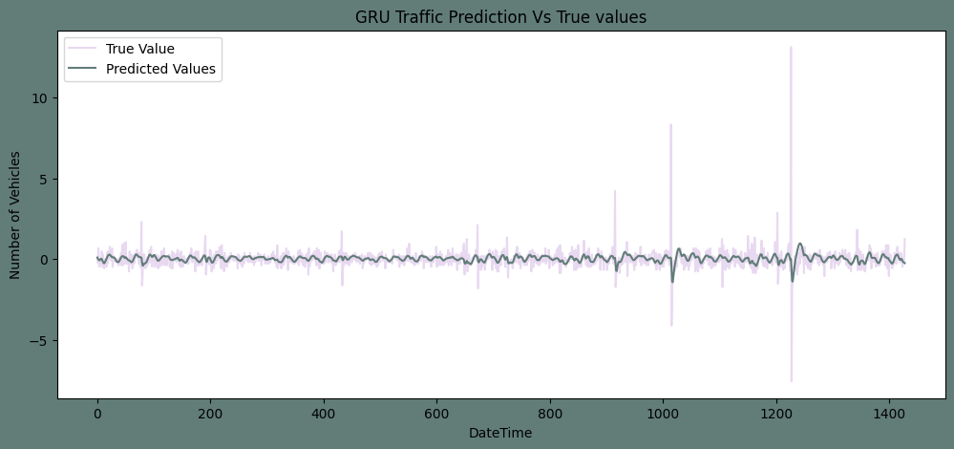
Results
Notes:
We applied the k-means algorithm to cluster participants based on their current status and level of study. The features were current status and level of study, and the target was the cluster label generated by the k-means algorithm. The optimal result of k-means was 6 clusters, and these clusters had different frequencies(see figure 13).

Slide 16
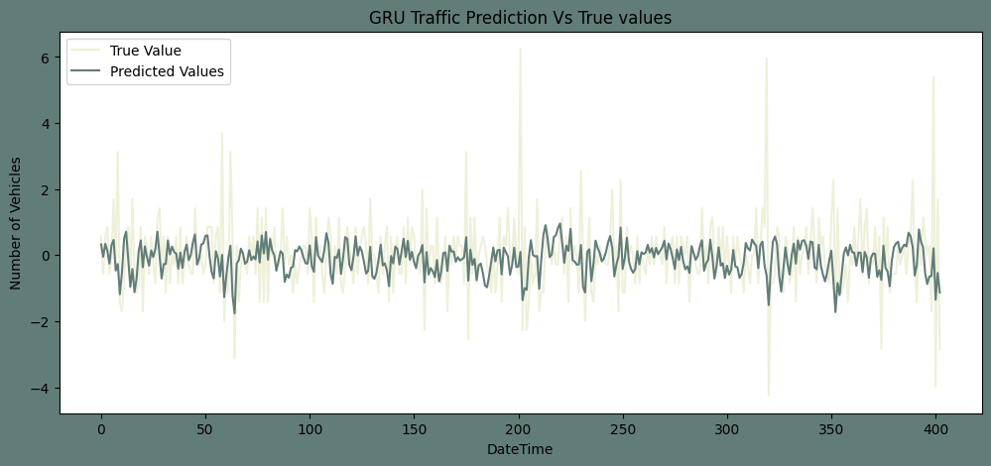
Results
Notes:
We applied the k-means algorithm to cluster participants based on their current status and level of study. The features were current status and level of study, and the target was the cluster label generated by the k-means algorithm. The optimal result of k-means was 6 clusters, and these clusters had different frequencies(see figure 13).

Slide 17
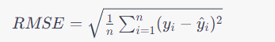
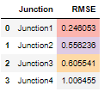
Results
RMSE stands for Root Mean Square Error:
It is a commonly used metric to measure the accuracy of a prediction or an estimator in statistical modeling and machine learning.
In our case here are the results :
Notes:
We applied the k-means algorithm to cluster participants based on their current status and level of study. The features were current status and level of study, and the target was the cluster label generated by the k-means algorithm. The optimal result of k-means was 6 clusters, and these clusters had different frequencies(see figure 13).

Slide 18

Conclusion :
The Number of vehicles in Junction one is rising more rapidly compaired to junction two and three.
The sparsity of data in juction four bars me from making any conclusion on the same.
The Junction one's traffic has a stronger weekly seasonality as well as hourly seasonality. Where as other junctions are significantly linear.
14

Slide 19

Notes:
Notre présentation touche a sa fin je vous remercie pour votre attention vos remarques et questions sont les bienvenues

